Slide 1

PEOPLE OF ACTION CAMPAIGN
Subject: Rotary Public Image
Presenter: ARPIC Nijad K. Al Atassi, D2452
Date: 14th October 2017

Slide 2
WHAT IS PEOPLE OF ACTION CAMPAIGN ? (INTRODUCTION)
People of Action is a new global public image ad campaign of the Rotary International
It was launched at the Rotary International Assembly in January 2017
Rotary unveiled the campaign, at the Rotary International Convention last June in Atlanta, Georgia, USA
The campaign materials are available on our Brand Center, and new materials will arrive over the next 18 months
Slide 2

Slide 3
WHAT IS PEOPLE OF ACTION CAMPAIGN ?
People of Action campaign is:
  To tell Rotary’s story in a consistent and compelling way
  To highlight the impact we make around the world
The campaign aims:
  To heighten the growing awareness of Rotary
  To deepen the public’s understanding of who we are, the work we do, and the impact we have in communities across the globe.
Slide 3

Slide 4
WHY WE NEED THE CAMPAIGN ?
Despite more than a century of Rotarians philanthropic works, many people don’t understand what Rotary is, how we’re different, and why they should engage with us.
Many people don’t know much about Rotary and how Rotary International organization has made an impact in helping the communities.
To thrive in the 21st century, Rotary needs a strong identity.
The 1.2 million membership is almost the same as 10 years ago, through the clubs has increased.
Slide 4

Slide 5
WHY WE NEED TO FURTHER STRENGTHEN OUR BRAND ?
We need to strengthen our logo, our color, our Brand in the community
Our identity is the essence of who we are and what we do
Strong Image helps us to tell the Rotary initiative in a compelling way
Strong Brand provide a clear and consistent image of what Rotary stands for and how we differ from other charitable organizations
With our strong image, we can offer prospective members, donors, and other stakeholders a compelling reason to engage with us
Slide 5

Slide 6
WHAT ARE OUR CAMPAIGN OBJECTIVES?
To narrow gap between awareness & understanding
To define ‘What is Rotary,’ Impact Rotary makes
To lay foundation for member engagement, cause, donation and other activities
To Allow Rotary clubs to localize ads for relevance
Slide 6

Slide 7
WHAT ARE OUR CAMPAIGN STRATEGY?
Highlight Rotarians as People of Action
Where others see problems, Rotarians see solutions, possibilities for their community
Share vision with fellow members and community partners and experts to exchange ideas about potential, lasting solutions
Mobilize others to take action to bring those ideas to life
Slide 7

Slide 8
WHAT ASSETS ARE BEING DEVELOPED?
Rotarians will be able to leverage a suite of new ads including:
  Videos
  Print Ads
  Outdoor ads
  Digital Ads
  Radio spot
  Brochure
  Campaign guidelines
Advertising assets will be produced in all Rotary languages
Slide 8

Slide 9
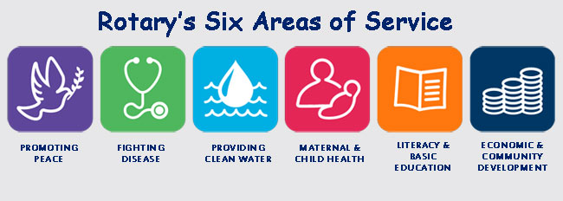
WHAT ASSETS ARE BEING DEVELOPED?
First wave: Build understanding of Rotary and position us as People of Action
Second wave: Build understanding of the Club experience and value of membership
Third wave: Build understanding around areas of focus
Slide 9

Slide 10
WHAT CAN WE DO NOW ?
Build a network of communications experts
Spread the word and incorporate public image into your trainings
Gather and share your people of action stories
Familiarize yourself with and use existing public image resources
Slide 10

Slide 11
WHAT CAN WE DO NOW ?
As a regional leader, we can start:
spreading awareness of this campaign
plan strategies to apply it in your community
monitor our Brand Center for more materials in July.
For background on the campaign and a sneak peek at one of our People of Action assets, see Rtn. Joe Otin’s video / speech from the 2017 International Assembly.
Slide 11

Slide 12
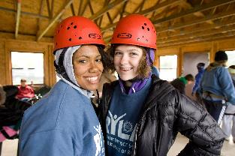

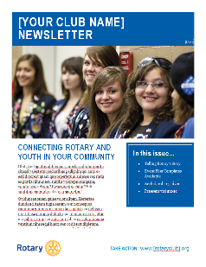
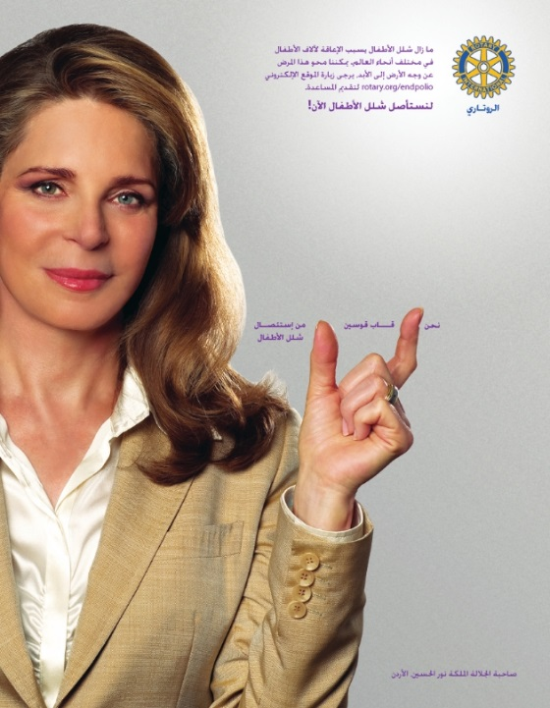
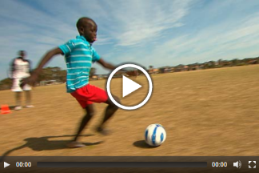

RESOURCES: BRAND CENTER WHAT YOU’LL FIND
www.rotary.org/brandcenter
Slide 12

Slide 13



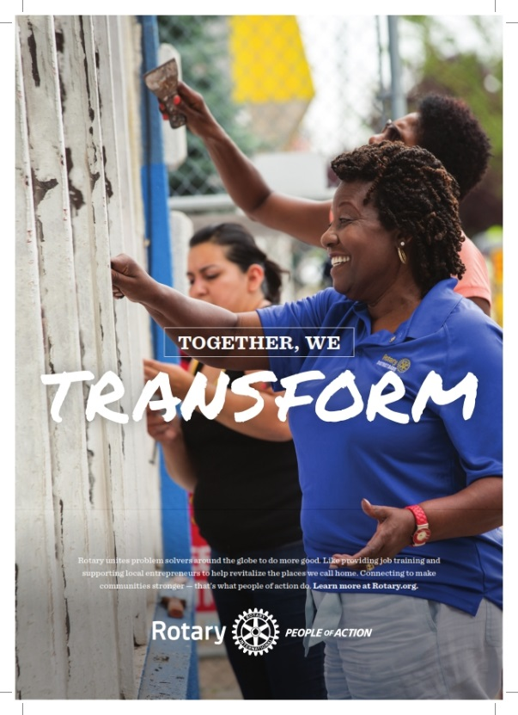
WE ARE PEOPLE OF ACTION
Slide 13

Slide 14

WE ARE PEOPLE OF ACTION
May God Bless Us All.

